Slide 1
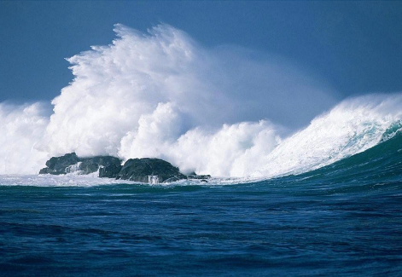

IRCC11-06.1A
Report of the MSDI Working Group to IRCC11
Genoa, Italy 3-5 June 2019

Slide 2
Outline of NHC
Membership
Chair: Jens Peter Weiss Hartmann, Denmark
Vice-Chair: Sebastian Cariso, USA
Secretary: John Pepper, OceanWise (until March 2019)
Assistant Director Alberto Costa Neves, IHO Secretariat (from March 2019)
Member States:
Argentina, Australia, Brazil, Canada, Cuba, Denmark, Estonia, Finland, France, Germany, Indonesia, Italy, Japan, Malaysia, Nigeria, Netherlands, New Zealand, Norway, Philippines, Portugal, Republic of Korea, Romania, Slovenia, Spain, Singapore, Thailand, Ukraine, UK, USA
Expert Contributors:
OGC; ICPC/EGS Group; Teledyne Caris; Esri; GSDI Association; OceanWise; YottaOcean Inc.; Geosciences Australia; IIC Technologies Inc.

Slide 3
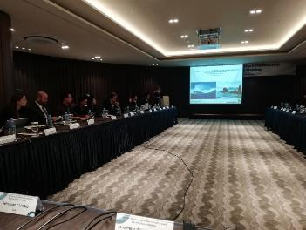
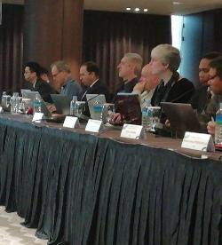
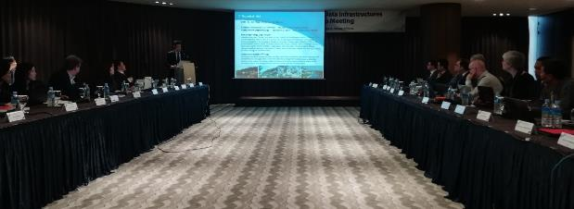
Meetings since IRCC10 (June 2018)
Meetings:
The MSDIWG10 meeting of IHO Marine Spatial Data Infrastructures Working Group (MSDIWG) took place in Busan, Republic of Korea, 4 - 5 March 2019. The meeting was followed by the OGC Marine DWG Meeting, 6 March 2019 and the UN-GGIM Working Group on Marine Geospatial Information (WGMGI1) Meeting, 7 - 9 March 2019.
Dates and venue for next meeting.
The IHO/MSDIWG will arrange a MSDI Open Forum meeting, the MSDIWG11 meeting with an integrated OGC Marine Domain WG part in 2020 in Rostock, Germany 24-27 February.

Slide 4
Principal activities and achievements
A | Communication and dissemination
B | Operational - Data sharing and management
C | Policies and governances – RHC. (Ensure that MSDI is a standing agenda item for RHCs’ meetings (IHO Res 2/1997, as amended, refers))
D | Standards (OGC and HSSC)
E | Innovation – Future perspectives (2021 - 2023)
F | Training and education
G | Maintain and extend the publication IHO MSDI C-17 (IHO Task 3.9.2.1 refers)
H | Conduct annual meetings of MSDIWG, arranged back to back with 1-day MSDI Open Forum (IHO Task 3.9.1 refers)

Slide 5
New Terms of Reference of MSDIWG.
The IRCC10 meeting agreed that the IHO MSDIWG should follow the development in MSP implementation worldwide and focus on the following topics:
• establish a list of relevant MS National MSP Data Contact Points
and contact persons
• establish a list of additional relevant institutions,
contact person/data experts
• study the most relevant MSP issues in a cross-border / trans-boundary
context in relation to data and information seen from a MS perspective
• compile minimum requirements for Hydrographic data for MSP Data and
recommendations of distribution/sharing of this data
• provide an overview on (national / regional) MSP best practice
• establish MSP on the IHO website under body of knowledge.
Consequently, the MSDIWG Terms of Reference and Rules of Procedures has been adjusted to address these topics (Annex C).
The MSDIWG Terms of Reference and Rules of Procedures has also been adjusted to be aligned with the other IRCC WGs.

Slide 6
Activities
The main subjects dealt with during the reporting period:
Information on MSDI implementation from MSDIWG members
MSDI training and e-learning
Maturity Assessment template to RHC
Update of C 17
The IHO/OGC conceptual study
Cooperation with OGC
Cooperation with UN-GGIM
Communication
The MSDIWG to focus on “security”
IHO strategic plan and establishing a draft IHO MSDIWG input
Spatial Data Quality
S-100
Cooperation with the International Cable Protection Committee

Slide 7
RHC MSDI Ambassadors
IRCC9/18. RHC Chairs to encourage Member States in the region to nominate RHC MSDI
Ambassadors to promote MSDI and to help Member States to prepare the national reports with respect
to the status of MSDI.
A vital element of this work would be to collect and collate responses from Member State on MSDI prior to each RHC meeting. It is becoming more important to consider taking MSDI as a RHC agenda item, therefore we hope to see a National MSDI report prepared by each Member State for submission to every RHC. The report should incorporate the status of MSDI, plans for involvement in MSDI and challenges facing the HO.
It is recommended that the National Reports include the topics from C-17, item 2.1 on what constitutes a MSDI:
• Policy and Governance
• People & Organizations
• Enablers (the framework for data acquisition, management, updating and dissemination)
o Standards
o Technology
o Metadata
• IHO S-100 Universal Hydrographic Data Model
• Content
• Education and Learning

Slide 8
MSDI Concept Development Study (MSDI-CDS)
IRCC9/19. Coordinator USA and IHO Secretariat to consider the OGC proposal and seek for funding and report back to the IRCC
At the MSDIWG meeting in Vancouver 2017, the MS discussed the possibility to create an OGC study that could establish the framework for future development of MSDI.
The proposal to launch an IHO Concept Development Initiative was presented at the IRCC9 meeting.
The following are objectives outlined in the proposal:
- Document the current state of MSDIs
- Document the needs for an MSDI based on current emerging technologies
- Document strategies to interoperate with other Spatial Data Infrastructures
- Develop a common interoperability reference architecture
- Engage with experts from across the user community as well as from the
community of technology / information and services providers, including
hydrographic offices, industry, government, research,

Slide 9
MSDI training material
The establishment of MSDI training material, including the teaching material, will be divided into two phases:
Phase 1. MSDI orientation. The course is aimed at students who are marine-focused, but have very little experience of MSDI concepts or practice.
Phase 2. Fundamentals of a Marine Spatial Data Infrastructure. The course is aimed at students who are marine geospatial professionals but who have very little experience of MSDI. It is designed as an introductory, one-day course in the fundamentals of MSDI concepts, theory, and practice.
There are two main uses of these documents in conjunction with the course slides themselves.
1. A participant who wants to download and self-learn from the materials provided.
2. A participant who wishes to deliver the materials in a group setting with stakeholders.

Slide 11
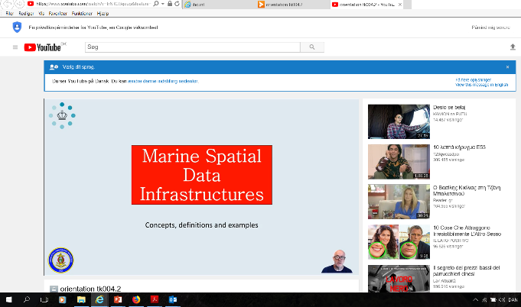
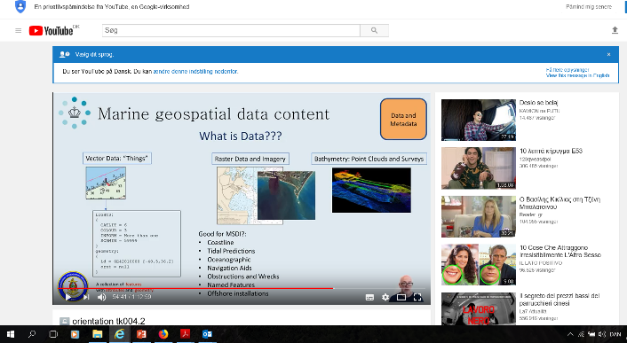
The MSDI eLearning course
Two MSDI courses
Orientation eLearning course
Fundamentals eLearning course

Slide 12

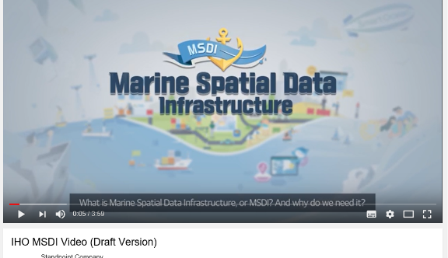
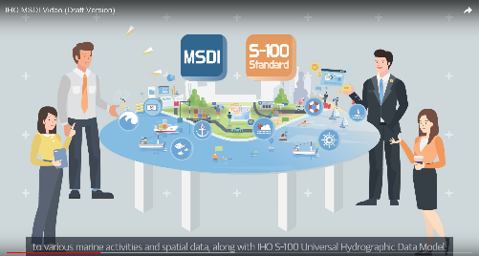
Activities and achievements
Communication and dissemination

Slide 13
Data integrity, marine boundaries from a MSDI perspective.
The MSDIWG has discussed data security from a MSDI perspective.
The conclusion the MSDIWG came to when looking at these issues from the MSDI perspective was that one of the main priority is actually data “integrity”, also dealt with comprehensively by IHO S-63:
(1) knowing who a piece of data came from (2) the knowledge that the data has not changed in its journey to the end user.
This is important from a MSDI perspective because the core concept of MSDI is reuse of marine geospatial data outside its traditional use case of primary SOLAS navigation, and within a much broader sphere of activity.
The nature of some of the datasets may well be sensitive, not because they are confidential, but because there is a high impact cost of them being wrong. If an MSDI provider wrongly attributes a dataset to a particular official body or incorrectly reproduces a dataset (either by visualizing it poorly or providing a copy of the incorrect data), the repercussions can be large.
The challenge technically is to provide the means and mechanisms, therefore, to protect the data integrity and assure the end user of the provenance of the data they are receiving.
- Ongoing the IHO and MSDI community needs to consider this issue
- Consider adapting existing mechanisms:
  • IHO S-63 (and S-101) relies on a specific end user system
  • Other standards exist but may need adaptation (e.g. Blockchain technology)
  • All data integrity systems require a “trust network” to define identity.

Slide 14
UN-GGIM
Figure 4. Extending fundamental geospatial data themes within the National Spatial Data Infrastructure (NSDI) to accommodate the SDGs and targets by means of the global indicator framework.

Slide 15
Problems Encountered
Problems Encountered
The main challenges for the MSDIWG is to raise awareness of the importance of MSDI, and to provide training and education to support MSDI development at the Member State and RHC levels. These challenges are being addressed with the training material (in development), the planned upgrade of the C-17 and the establishment of MSDI Ambassadors at RHCs.
Justification and Impacts
The work in the MSDIWG is progressing well and a supporting Action Plan has been established.
The Work Programme creates the framework for the WG, in order to cope with the challenges in a forward-looking perspective.
The creation of regional MSDIWGs will give the Member States direct possibility to actively participate in the development of a well-functioning MSDI within the region’s hydrographic domain and its surroundings. Additionally, regional MSDIWGs benefit from both national and regional SDI activities in order to lead and address MSDI matters for the countries in the region.

Slide 16
Action Required of IRCC
The IRCC is invited to:
note the report
b. take note of the MSDI Concept Development Study (MSDI-CDS)
c. approve the new ToR and RoP (Annex C)
d. discuss if the recommended topics to be included in the MS MSDI presentations is sufficient
e. acknowledge and support the work of the IHO Project Team on the implementation of the
UN- GGIM Shared Guiding Principles for Geospatial Information within the IHO.
f. discuss any item with relevance to SDI/MSDI/MSP and to take appropriate actions.

